Slide 1
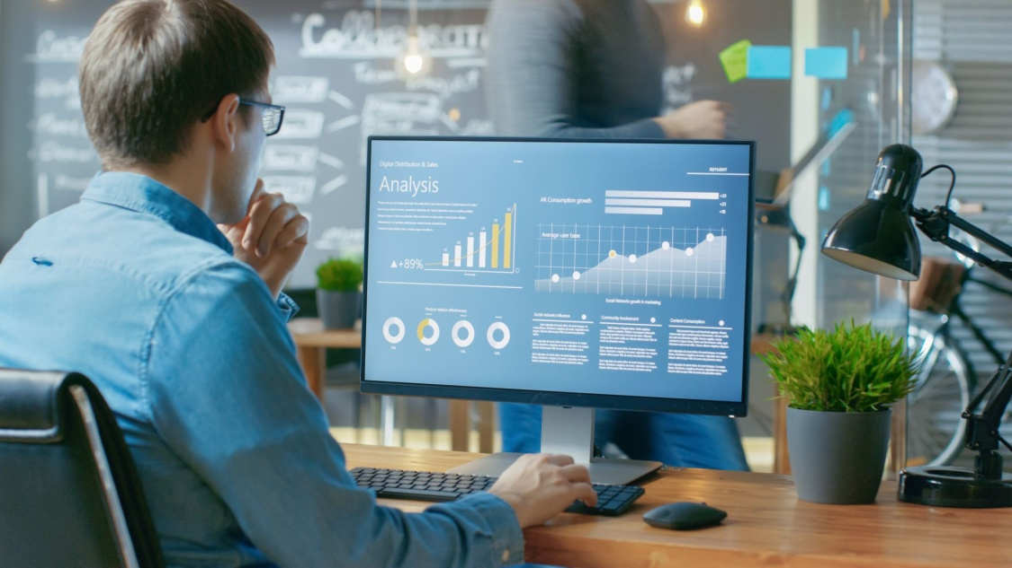
Why Machine Learning?

Slide 2
Where Machine Learning?

Slide 3
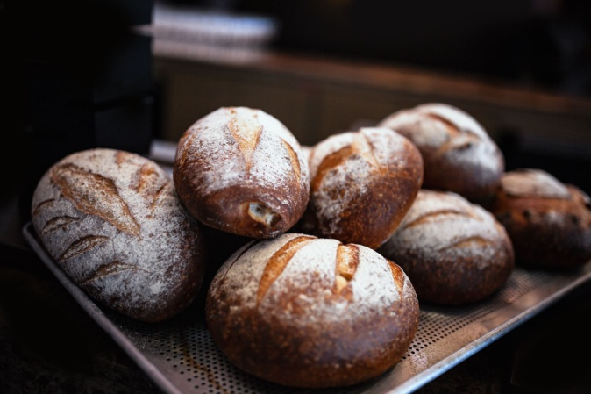
No of Chappaties and weight increased?
No of Chappaties | Weight increased (in gms)
2 | 250

Slide 4
No of Chappaties and weight increased?
No of Chappaties | Weight increased (in gms)
2 | 250
4 | 500

Slide 5
No of Chappaties and weight increased?
No of Chappaties | Weight increased (in gms)
2 | 250
4 | 500
7 | 750

Slide 6
No of Chappaties and weight increased?
No of Chappaties | Weight increased (in gms)
2 | 250
4 | 500
7 | 750
10 | 1000

Slide 7

No of Chappaties and weight increased?
No of Chappaties | Weight increased (in gms)
2 | 250
4 | 500
7 | 750
10 | 1000
12 | ?

Slide 8
Guess the next number?
No of Chappaties | Weight increased (in gms)
2 | 250
4 | 500
7 | 725
10 | 1000
12 | 1250

Slide 9
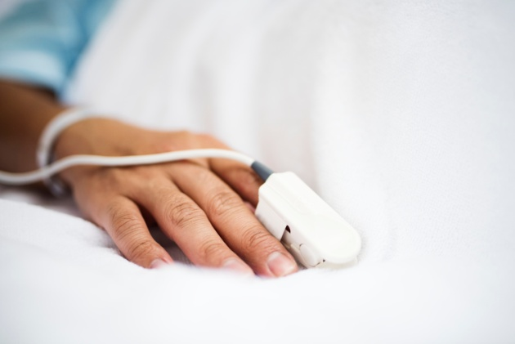
No of COVID patients and Deaths?
Real Scenario
No of Patients | Deaths in Day
12 | 5

Slide 10
No of COVID patients and Deaths?
Real Scenario
No of Patients | Deaths in Day
12 | 5
24 | 12

Slide 11
No of COVID patients and Deaths?
Real Scenario
No of Patients | Deaths in Day
12 | 5
24 | 12
31 | 19

Slide 12
No of COVID patients and Deaths?
Real Scenario
No of Patients | Deaths in Day
12 | 5
24 | 12
31 | 19
9 | 22

Slide 13
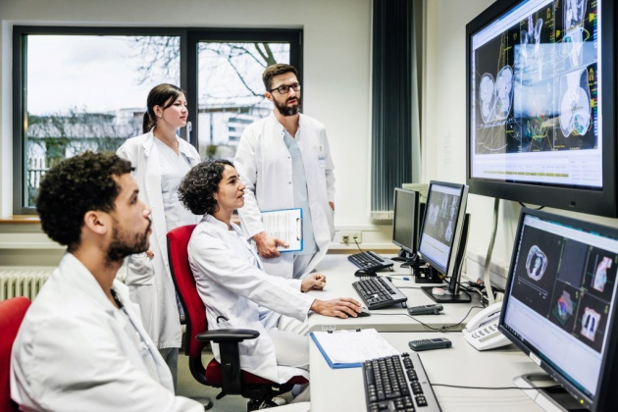
No of COVID patients and Deaths?
Real Scenario
No of Patients | Deaths in Day
12 | 5
24 | 12
31 | 19
9 | 22
17 | 3

Slide 14
No of COVID patients and Deaths?
Real Scenario
No of Patients | Deaths in Day
12 | 5
24 | 12
31 | 19
9 | 22
17 | 3
53 | 25

Slide 15
No of COVID patients and Deaths?
Real Scenario
No of Patients | Deaths in Day
12 | 5
24 | 12
31 | 19
9 | 22
17 | 3
53 | 25
12 | 19

Slide 16

No of COVID patients and Deaths?
Real Scenario
No of Patients | Deaths in Day
12 | 5
24 | 12
31 | 19
9 | 22
17 | 3
53 | 25
12 | 19

Slide 17
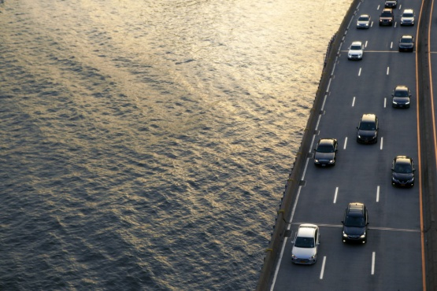
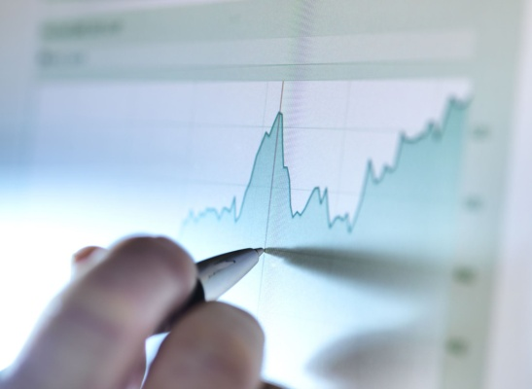


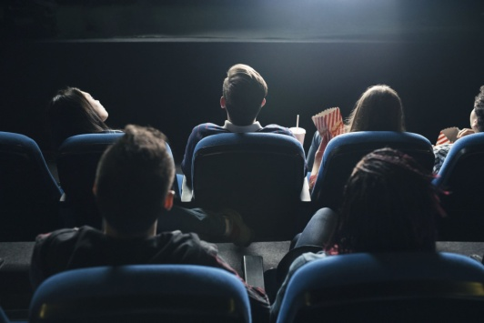
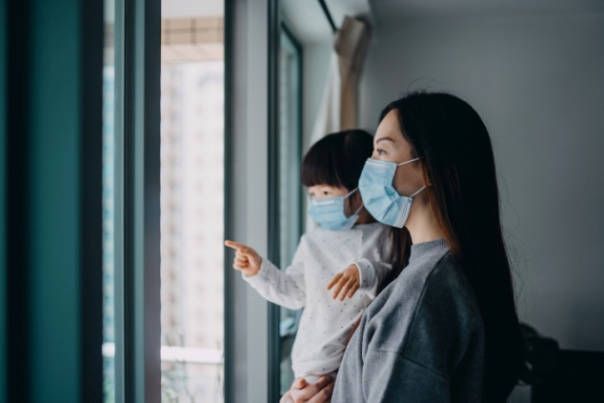
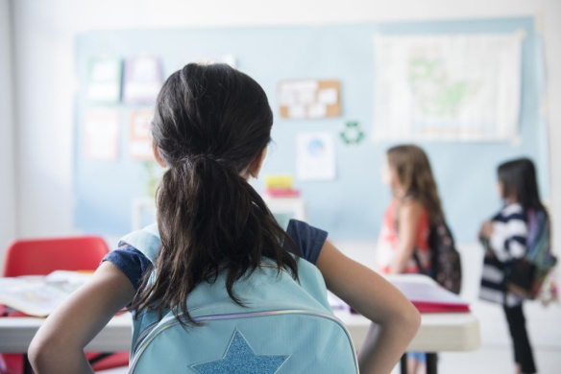
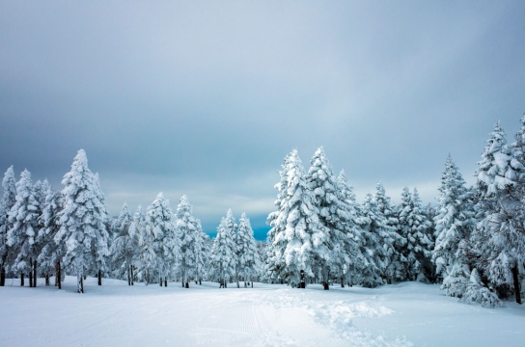
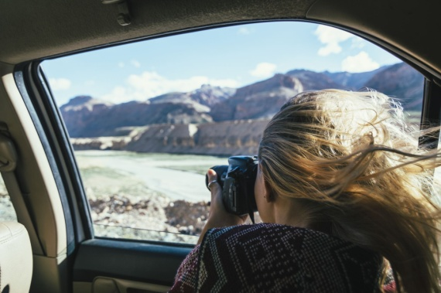
Real Scenario
Cases
Number of vehicles passed from toll plaza in particular time
Stock Price Prediction
Suggesting products, movies, or content based
Using AI to assist in medical diagnosis
Developing self-driving cars
predict future weather patterns
No of admission in School

Slide 18
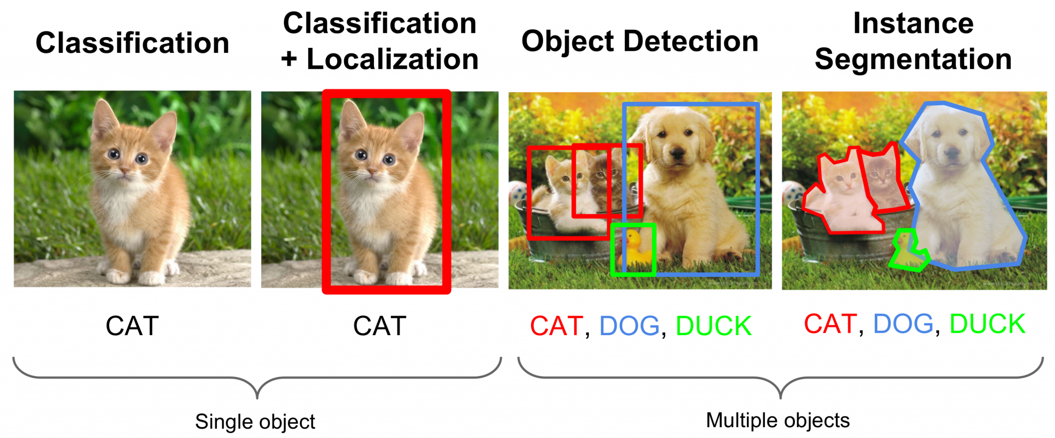
Machine Learning and Machine work?
Image Classification: Machine Learning
a system that can automatically classify images of cats and dogs

Slide 19
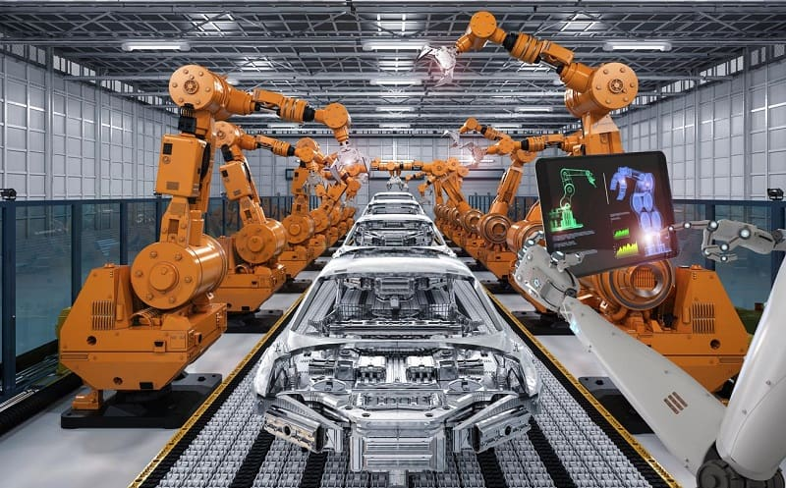
Machine Learning and Machine work?
Manufacturing: Machine Work
an automotive assembly line, robotic arms and machines are used to weld components together, apply paint, and perform precision measurements.

Slide 20
Machine Learning and Machine work?
Image Classification: Machine Learning
a system that can automatically classify images of cats and dogs
Manufacturing: Machine Work
an automotive assembly line, robotic arms and machines are used to weld components together, apply paint, and perform precision measurements.

Slide 21
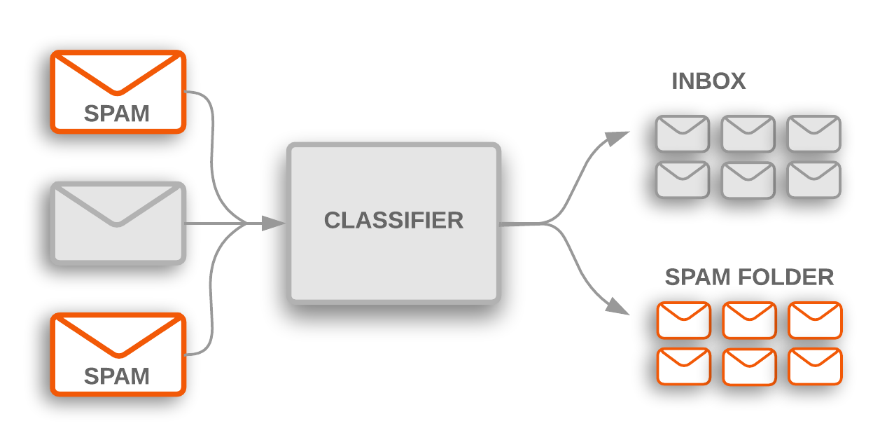
Machine Learning and Artificial Intelligence?
Spam Email Classification: Machine Learning
automatically classify emails as either "spam" or "not spam"

Slide 22
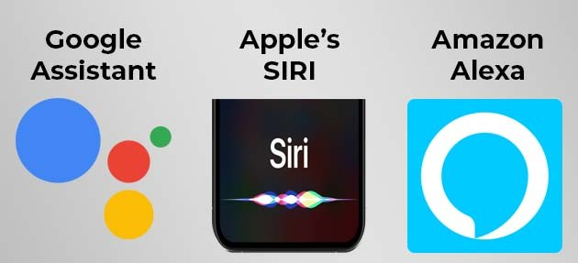
Machine Learning and Artificial Intelligence?
Virtual Personal Assistants: Artificial Intelligence
Virtual personal assistants like Siri, Google Assistant, and Amazon Alexa are examples of artificial intelligence.

Slide 23
Machine Learning and Artificial Intelligence?
Spam Email Classification: Machine Learning
automatically classify emails as either "spam" or "not spam"
Virtual Personal Assistants: Artificial Intelligence
Virtual personal assistants like Siri, Google Assistant, and Amazon Alexa are examples of artificial intelligence.

Slide 24
AI, ML and Deep Learning
Artificial Intelligence
Machine Learning
Deep Learning

Slide 25
Tasks Not Necessarily Requiring Machine Learning
Sorting Algorithms
Playing games like Tic-Tac-Toe
Basic Text Search

